Slide 1


Slide 2
HELLO
WORLD!
INDEX
01. Introduction
02. Game Concept
03. Game Features
04. Scope

Slide 3


INTRODUCTION
Quality
Welldone
Energentic
Royal
Team
Yeah

Slide 4
INTRODUCTION
TEAM MEMBER
PRODUCT MANAGER
WONJU_CHO
| TECHNICAL MANAGER
MINKI_CHO
| DESIGNER
GUYOUN_PARK
| PRODUCER
UIJIN_LEE

Slide 5
INTRODUCTION
BOXES
+
ESCAPE
BOX ES CAPE

Slide 6

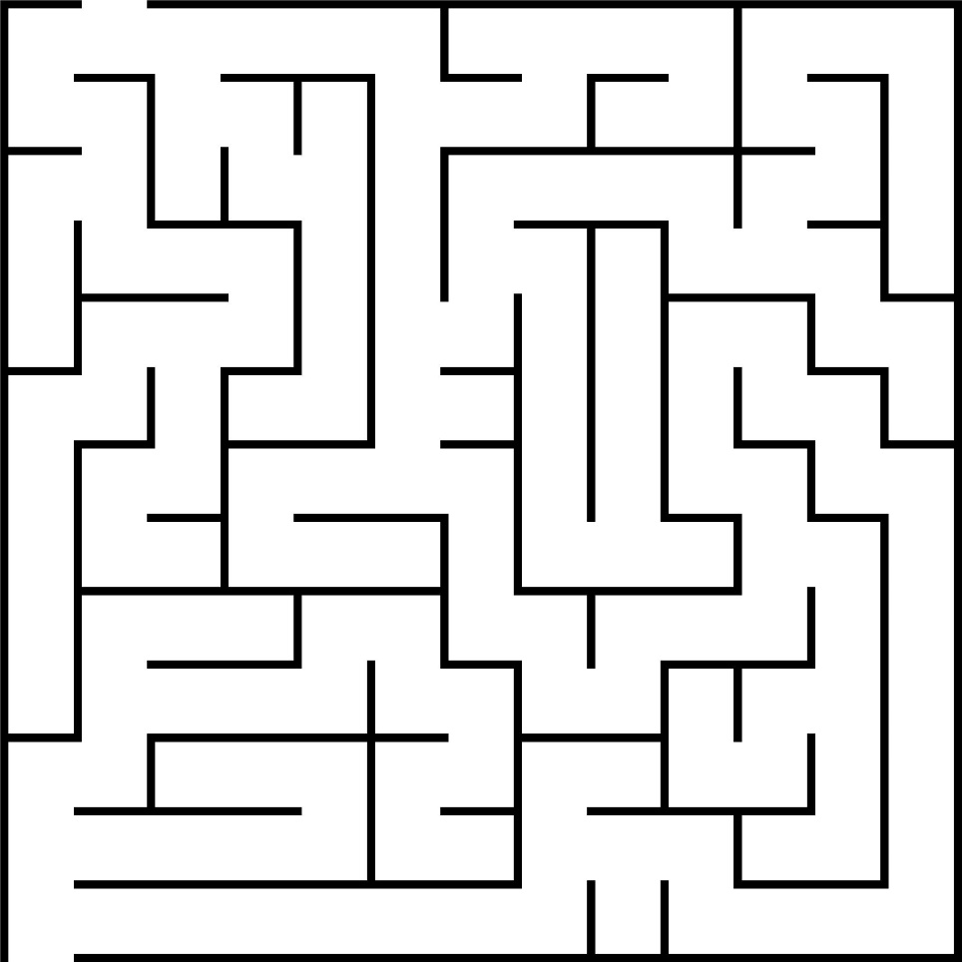
GAME CONCEPT
+

Slide 7

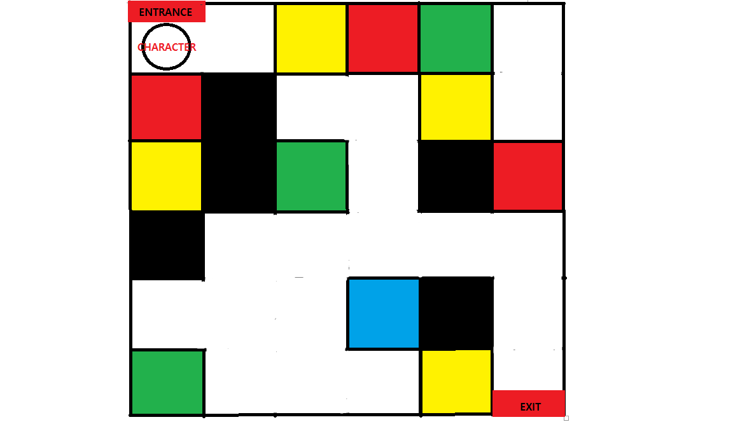




GAME FEATURES - PUZZLE

Slide 8
GAME FEATURES - MAZE

Slide 9
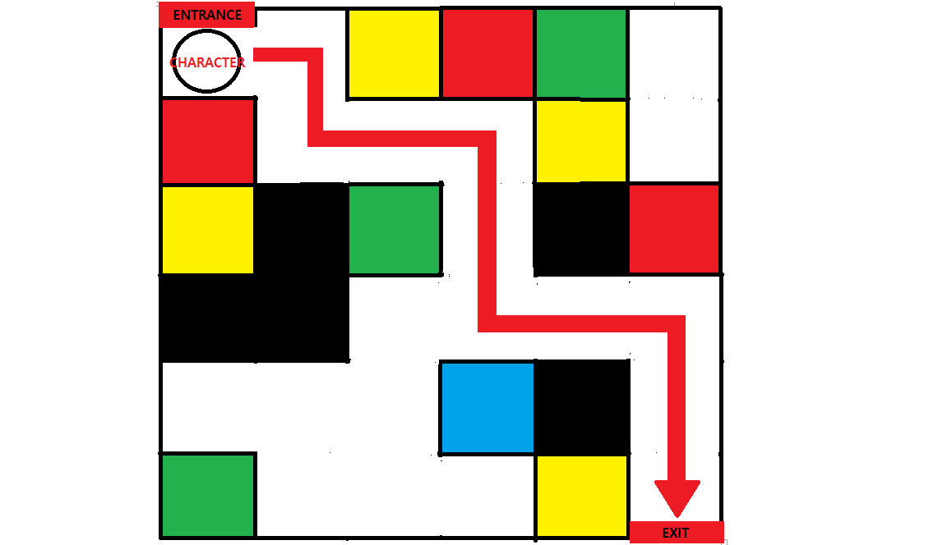
GAME FEATURES - NAVIGATION

Slide 10
GAME FEATURES
Calculates the score
according to the count of movements

Slide 11
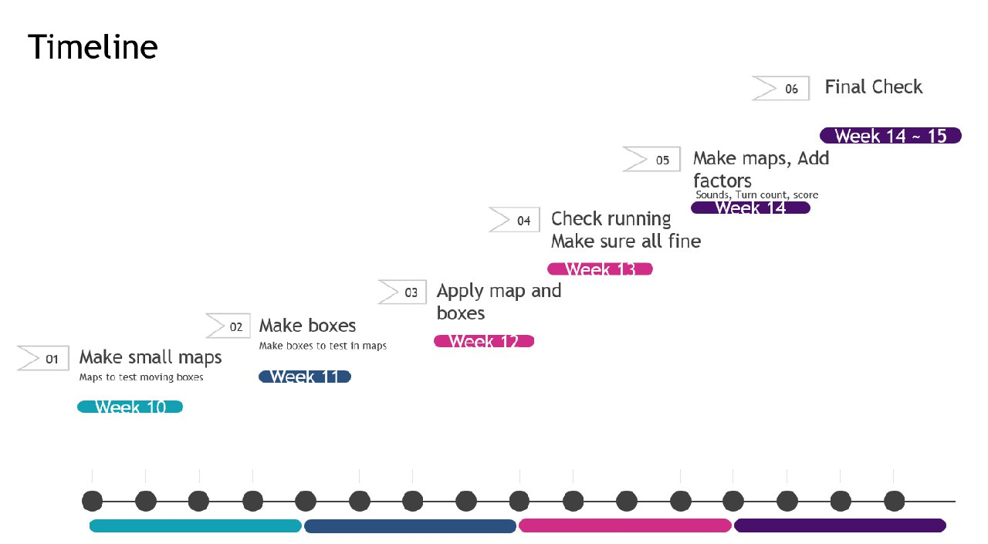
SCOPE

Slide 12
SCOPE
RISKS:
1.Difficulty in coding
2.Time Management Failed
3. Meeting missed

Slide 13
SCOPE
MITIGATIONS:
1.Ask the professor
2.stay up all night in the last day of schedule
3.Use facetime or kakaotalk

Slide 14
Q&A
Q&A

Slide 15
End
Thank You!

